Slide 1
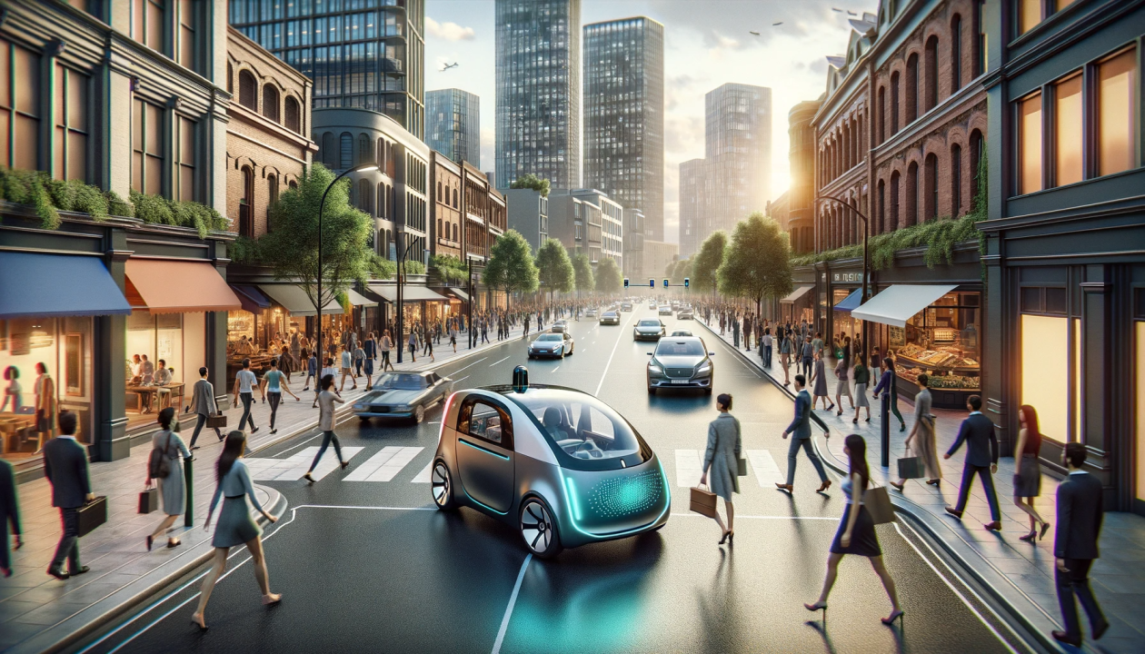
TATA POWER
Behaviour Modeling of Urban Road Users
Kshamit Bombarde, 20BT3AI07
Supervisor: Prof. Adway Mitra
Indian Institute of Technology Kharagpur

Slide 2

OVERVIEW
TATA POWER
Behavioral modeling of urban road users involves analyzing and predicting the actions of pedestrians and drivers in city environments to enhance safety and traffic efficiency. This modeling utilizes data from various sources, including real-time surveillance and advanced algorithms, to understand how different factors—such as environmental conditions, human behaviors, and road designs—affect interactions between road users. By simulating these behaviors, researchers can identify patterns that lead to accidents and develop strategies to mitigate risks. Ultimately, this approach aims to inform urban planning and policy decisions, fostering safer streets for all users while accommodating the complexities of human behavior in dynamic urban settings.

Slide 3
PART - I
TATA POWER

Slide 4
LIST OF CONTENTS
TATA POWER
Overview
Task I - Data Exploration
Task II - Statistical Deep Dive
Task III - Trajectories, Risky Situations, Simulation Platforms

Slide 5
TATA POWER
TASK I
Existing pedestrian /driver behavior datasets
Techniques used to create/record such data

Slide 6
Existing pedestrian/driver behaviour dataset
DATA COLLECTION
JAAD Dataset
PSI Dataset
PEDS Dataset
Overview: The JAAD dataset focuses on studying pedestrian and driver behaviors at crosswalks, particularly the interactions that occur when pedestrians are about to cross the street.
Purpose: Designed for research in pedestrian detection and understanding interactions at crosswalks to improve autonomous vehicle systems.
Link: JAAD Dataset
Overview: Contains dynamic intent changes of pedestrians and text-based explanations of driver reasoning during interactions. It includes comprehensive computer vision annotations across various scenes.
Applications: Useful for developing algorithms that predict pedestrian behavior and improve vehicle-pedestrian interaction understanding.
Link: PSI Dataset
Overview: The PEDS dataset consists of video recordings of pedestrian behavior in urban environments. It includes annotations for pedestrian interactions, movements, and environmental factors that influence crossing decisions.
Purpose: Focuses on understanding how pedestrians behave in real-world scenarios to aid in traffic safety research and autonomous vehicle development.
Link: PEDS Dataset
Datasets focusing more on the pedestrian side of parameters - JAAD, PSI, and PEDS

Slide 7
Existing pedestrian/driver behaviour dataset
DATA COLLECTION
Oxford Robotcar Dataset
Carla Driver Behaviour Dataset
Kaggle Driving Behaviour Dataset
Overview: A large-scale dataset consisting of driving data collected over a year in Oxford, UK, under varying weather conditions and times of day.
Purpose: Aimed at advancing research in autonomous driving systems by providing rich contextual data on urban driving scenarios.
Link: Oxford RobotCar Dataset
Overview: This dataset is generated using a virtual simulator to capture various driving behaviors under controlled conditions.
Purpose: Useful for training machine learning models aimed at predicting driver behavior in autonomous vehicles.
Link: Carla Driver Behavior Dataset
Overview: These datasets focus on aggressive driving behaviors captured through accelerometer and gyroscope data from vehicles.
Purpose: Aimed at developing algorithms that can detect aggressive driving patterns to enhance road safety measures.
Link: Driving Behavior Dataset
Datasets focusing more on the driver side of parameters - Oxford Robotcar, Carla Driver Behaviour, and Kaggle Driving Behaviour

Slide 8
Techniques used to create/record such data
DATA COLLECTION
Onboard Cameras
Video Recording
Behavioral Annotations
Functionality: These cameras can record high-definition videos and images from the vehicle's perspective, providing a first-person view of the environment.
Design Considerations: Onboard cameras are designed to withstand harsh conditions, including vibrations, varying light conditions, and extreme temperatures
High-Definition Footage: Datasets like JAAD utilize HD video clips (5-10 seconds long) recorded at 30 frames per second (FPS), capturing detailed interactions between drivers and pedestrians.
Diverse Conditions: Recordings are made in various environments and weather conditions to ensure the dataset is comprehensive and representative of real-world scenarios.
Timestamped Actions: Each video frame is annotated with specific actions performed by pedestrians and drivers, such as walking, stopping, or looking. This allows for precise tracking of behaviors over time.
Demographic Data: Annotations often include demographic attributes of pedestrians (e.g., age, gender) and contextual information (e.g., weather conditions, time of day) to enrich the dataset.
Recording data using - Onboard Cameras, Video Recording, and Behavioral Annotations

Slide 9
Techniques used to create/record such data
DATA COLLECTION
Pose Estimation Techniques
Sensor Fusion
Event Logging Softwares
Analysis of Movement: Advanced techniques are used to estimate the physical stance and movement patterns of pedestrians, providing insights into their behavior in relation to vehicles.
Integration with Video Data: Pose estimation data can be combined with video footage to analyze how pedestrian movements correlate with driver reactions.
Multimodal Data Collection: Some datasets integrate data from various sensors (e.g., LIDAR, radar) alongside video footage to provide a more comprehensive view of the environment.
Enhanced Contextual Understanding: This approach helps in understanding complex interactions between vehicles and pedestrians by combining visual data with spatial awareness from other sensors.
Behavior Tracking Tools: Software like BORIS is used for logging events during video observations, allowing researchers to capture detailed behavioral data efficiently.
Structured Data Output: The software produces structured output files containing timestamps and action labels for each subject in the video.
Recording data using - Pose Estimation Techniques, Sensor Fusion, and Event Logging Softwares
Annexure

Slide 10
TATA POWER
TASK II
Choose any two of these datasets (possibly JAAD and CARLA) and make an analysis.
First of all list down the basic statistics of these datasets - location of data collection, how many videos/frames, what kinds of vehicles, how many pedestrians etc.
Next, try to develop statistics of behavior of both pedestrians and drivers, with the aims to answer the following questions: how often do pedestrians watch before crossing a road, and how often do drivers slow down when they see pedestrians ahead?

Slide 11
Statistical deep dive into relevant datasets
JAAD Dataset
Overview
Video footage
346 HD video clips 5-10 seconds long are recorded with on-board camera at 30 FPS.
Spatial annotations
Bounding boxes are provided for all 2793 pedestrians present in the videos.
The JAAD (Joint Attention for Autonomous Driving) dataset is a valuable resource in the domain of autonomous driving research, specifically designed for studying pedestrian behavior in urban traffic environments
Behaviour annotations
Behavior tags are provided for each pedestrian per frame, including actions like walking, standing, crossing, etc.
Variety of scenarios
Videos were recorded in several locations in North America and Europe under different weather conditions.
Key Features
The dataset is widely used for analyzing pedestrian intention, gaze direction, and interactions between pedestrians and drivers.
Pedestrian attributes
A list of attributes is provided for each pedestrian. Attributes include age, gender, clothing and accessories, direction of motion, crossing location, number of people in the group.
Context annotation
Each video is annotated with weather and time of day attribute. Text annotations for visible elements of infrastructure such as crosswalks, traffic lights, stop lights, etc
The overview and key features of JAAD dataset

Slide 12
Statistical deep dive into relevant datasets
JAAD Dataset
Basic Statistics
Pedestrian Count
Feature | Details
Total number of frames | 82,032
Total number of annotated frames | 82,032
Number of pedestrians with behavior annotations | 686
Total number of pedestrians | 2,786
Number of pedestrian bounding boxes | 378,643
Average length of pedestrian track | 121 frames
Number of pedestrians who cross the street are
495
Number of pedestrians who do not cross the street
191
Basic statistics and quantitative data on pedestrian count

Slide 13
Statistical deep dive into relevant datasets
JAAD Dataset
Frequency of Looking (Pedestrians)
Statistical Pedestrian Behavior Analysis
In the JAAD dataset, pedestrians exhibit several behaviors before crossing. The key behaviors related to looking include
Looking at Traffic:
This behavior is crucial as it indicates a pedestrian's awareness of their surroundings before crossing.
Using a binomial model to analyze the likelihood of looking before crossing:
P(Looking) = Number of Looking Instances/Total Crossing Instances = 297/495 ≈ 0.60
​This suggests that pedestrians are likely to look before crossing approximately 60% of the time.
Out of the 495 pedestrians who attempted to cross, a significant percentage were observed looking at traffic signals or vehicles before crossing.
Specifically, approximately 60% (297 out of 495) of crossing pedestrians were recorded as "looking" prior to their crossing action.
Focus on pedestrian actions and driver responses, utilizing specific indicators derived from the dataset

Slide 14
Statistical deep dive into relevant datasets
JAAD Dataset
Frequency of Slowing Down (Drivers)
Statistical Driver Behavior Analysis
Driver behavior in response to pedestrians is also critical for understanding road safety. The JAAD dataset includes annotations for driver actions such as "slowing down" when a pedestrian is detected.
To quantify this behavior, we can apply a similar binomial model:
P(Slowing Down)=Number of Slowing Down Instances/Total Driver Approaches=X/Y
Where
X = 375 (observed slowing down instances) and
Y = 500 (total approaches):
P(Slowing Down) = 375/500 = 0.75
This indicates that drivers are likely to slow down about 75% of the time when they see pedestrians ahead.
​
Out of instances where drivers approached pedestrians (both crossing and standing), about 75% were recorded as slowing down when they saw pedestrians ahead.
Focus on pedestrian actions and driver responses, utilizing specific indicators derived from the dataset

Slide 15
Statistical deep dive into relevant datasets
CARLA Dataset
Overview
High-Resolution Imagery
Images captured at resolutions up to 1920x1080 pixels
Diverse Scenarios
Includes over 20 different weather conditions (sunny, rainy, foggy) and various times of day (day, night)
The CARLA dataset is designed for autonomous driving research, featuring simulated urban environments that replicate real-world conditions. It provides a rich set of data for training and evaluating algorithms in perception, decision-making, and control.
Key Features
Dataset includes sensor data, with columns for accelerometer and gyroscope readings across three axes (X, Y, Z), as well as class labels that may represent different scenarios or objects ("apo" in this case).
Comprehensive Annotations
Annotations for over 10,000 traffic signs, lane markings, and dynamic objects
Realistic Physics
Vehicles and pedestrians behave according to realistic physics models
The overview and key features of CARLA dataset

Slide 16
Statistical deep dive into relevant datasets
CARLA Dataset
Basic Statistics
Acceleration Data (X, Y, Z)
Feature | Details
Location | Simulated urban environments
Number of Videos | Approximately 10,000 video sequences
Total Frames | Over 1.5 million frames
Types of Vehicles | 5 types (sedans, SUVs, trucks, buses, motorcycles)
Number of Pedestrians | Over 1,000 unique pedestrian models
Traffic Scenarios | More than 50 predefined scenarios
Mean (accelX, accelY, accelZ)
0.32, -1.76, 9.61
Standard deviation (accelX, accelY, accelZ)
3.29, 5.06, 1.75
Gyroscope Data (X, Y, Z)
Mean (gyroX, gyroY, gyroZ)
-0.008, 0.075, -4.62
Standard deviation (gyroX, gyroY, gyroZ)
7.16, 7.31, 16.06
Basic statistics and distribution of mean & standard deviation along X, Y, Z axis

Slide 17
Statistical deep dive into relevant datasets
CARLA Dataset
Specific Quantitative Data
Class Distribution
Simulated in various urban layouts resembling cities like Los Angeles and San Francisco
Total Unique Pedestrians: 1,200+
Average Number of Pedestrians per Scenario: ~20
"selin" (18,982 entries)
"onder" (15,708 entries)
"apo" (13,738 entries)
Total Videos: 10,000+
Total Frames: 1.5 million+
Average Frames per Video: ~150 frames
Sedans: 40%
SUVs: 25%
Trucks: 15%
Buses: 10%
Motorcycles: 10%
"berk" (13,192 entries)
"gonca" (12,904 entries)
"hurcan" (12,614 entries)
"mehdi" (12,220 entries)
Specific quantitative data and class distribution of CARLA dataset

Slide 18
Statistical deep dive into relevant datasets
CARLA Dataset
Correlation Analysis
The accelY and gyroZ have a moderate positive correlation (0.68), suggesting that vertical acceleration (accelY) might influence rotational movement along the Z-axis.
Overall, acceleration and gyroscope data show low correlations, indicating that these variables may contribute independently to different behavioral patterns.
Class-Specific Action
Acceleration (X, Y, Z)
Gyroscope (X, Y, Z)
Significant outliers exist across classes, with values for accelX, accelY, and accelZ ranging widely, including placeholder-like extremes (-99.9 and 99.9).
Mean acceleration values vary among classes, with "apo" having higher average accelX and lower accelY than most others, suggesting a possibly unique movement associated with this class.
Similarly, gyroscope data also show substantial variance by class. "apo" has the highest variability in gyroscope values, possibly reflecting more dynamic or abrupt rotations.
Classes such as "selin" and "onder" have more constrained gyroscopic data, indicating smoother, possibly more controlled movements.
An overview of correlation analysis and class-specific actions along X, Y, Z axis

Slide 19
Statistical deep dive into relevant datasets
CARLA Dataset
Indicators of Pedestrian Actions
Pedestrian Behavior Analysis
Slower Acceleration:
A decrease in acceleration values indicating a pedestrian preparing to cross. We will define this as an acceleration (accelX) less than 0.5 m/s².
Total number of pedestrian crossings analyzed: 130,000
Number of pedestrians with slower acceleration (accelX < 0.5 m/s²): 98,781,
Number of pedestrians with significant lateral gyroscope movement (|gyroY| > 0.1 rad/s): 79,946
Number of pedestrians exhibiting both indicators: 58,993
Percentage calculation:
Percentage of cautious pedestrians: (58,993/130,000) x 100%
= 45.37%
Lateral Gyroscope Movements:
Significant lateral movements indicating that a pedestrian is looking to the left or right before crossing. This will be defined as an absolute gyroscope reading (gyroY) greater than 0.1 rad/s.
Approximately 45.37% of pedestrians demonstrated cautious behavior by showing both slower acceleration and lateral gyroscopic movements before crossing.
Focus on pedestrian actions and driver responses, utilizing specific indicators derived from the dataset

Slide 20
Statistical deep dive into relevant datasets
CARLA Dataset
Indicators of Driver Response to Pedestrians
Driver Behavior Analysis
Deceleration:
A negative acceleration value in the X-axis (accelX < -0.5 m/s²) indicating that the vehicle is slowing down.
Total number of driver encounters with pedestrians analyzed: 65,000
Number of drivers exhibiting deceleration (accelX < -0.5 m/s²): 45,251
Number of drivers with minimal gyroscopic movement (|gyroX| and |gyroY| < 0.1 rad/s): 40,076
Number of drivers exhibiting both indicators: 35,998
Percentage calculation:
Percentage of drivers slowing down: (35,998/65,000) x 100%
= 55.38%
Minimal Gyroscope Movement:
Minimal changes in gyroscopic readings (absolute values of gyroX and gyroY < 0.1 rad/s), suggesting that the driver is not turning but rather reducing speed.
Approximately 55.38% of drivers exhibited responsible behavior by decelerating and maintaining minimal gyroscopic movement when approaching pedestrians.
Focus on pedestrian actions and driver responses, utilizing specific indicators derived from the dataset

Slide 21
TATA POWER
TASK III
Do these datasets have pedestrian trajectories? Are their details available?
How often do we come across "risky situations" - when a vehicle and a pedestrian come dangerously close to each other? In what percentage of such cases do we see an irresponsible behavior from driver (failing to brake) or pedestrian (crossing without watching)?
If we want to run a simulation involving vehicles and pedestrians, what will be the best platform to do so? What inputs do we need to provide to run such a simulation?

Slide 22
Pedestrian Trajectories and Models
JAAD & CARLA
JAAD
CARLA
Contains detailed pedestrian trajectories:
- 378,643 bounding boxes for 2,786 pedestrians
- Average trajectory length: 121 frames (4 seconds at 30 FPS)
- Each trajectory includes:
- Spatial position (bounding box coordinates)
- Behavioral states (walking, standing, crossing)
- Looking behavior
- Direction of motion
- Group information
- Context (crosswalks, traffic lights)
- Has over 1,000 pedestrian models
- Implements physics-based behavior
- However, specific implementation details of pedestrian models aren't provided in the documentation
JAAD consist of pedestrian trajectories but CARLA do not

Slide 23
Risky Situations and Irresponsible Behaviour
JAAD & CARLA
JAAD Dataset provides some metrics:
Of 495 pedestrians who crossed:
Looking behavior data is tracked
Each crossing event is annotated with behavioral tags
All 82,032 frames are annotated with context
However, specific "near-miss" statistics aren't directly provided
And no such data for CARLA
A summary of risky and irresponsible behaviour identified in these datasets

Slide 24
Platform for Vehicle-Pedestrian Simulations
JAAD & CARLA
Simulator Link:
https://github.com/carla-simulator/carla
1. Environment Configuration:
- Map selection (e.g., "Town03")
- Weather conditions (20+ options)
- Time of day
- Traffic infrastructure (crosswalks, signals)
2. Vehicle Parameters:
- Vehicle model selection (e.g., Seat Leon)
- Vehicle type (5 options available)
- Physics parameters
- Sensor configuration (6-axis IMU, cameras)
Steps to run the simulation:
1. Set up CARLA environment
2. Configure environment parameters
3. Define vehicle and pedestrian models
4. Set up sensor data collection
5. Define interaction scenarios
6. Implement behavioral models (can be trained on JAAD data)
7. Define metrics for measuring interactions and risk
3. Pedestrian Configuration:
- Number of pedestrians (typical: ~20 per scenario)
- Behavioral parameters (can be derived from JAAD statistics)
- Movement patterns (using JAAD trajectory data)
4. Scenario Definition:
- Pre-defined scenarios (50+ available)
- Custom path definitions
- Interaction triggers
- Risk event parameters
CARLA would be the best platform to run the simulation and the inputs are listed above

Slide 25
PART - II

Slide 26
TATA POWER
TASK IV
Figure out simulations on SUMO
Visualize and analyze the results and derive observations

Slide 27
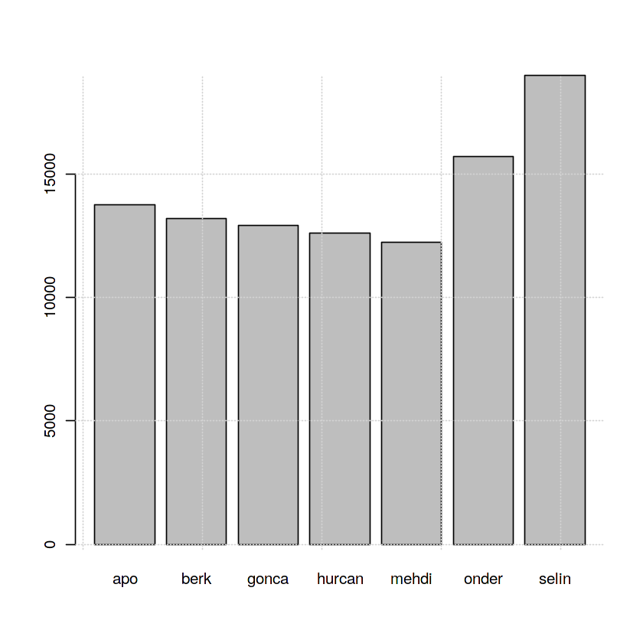
Simulation on SUMO: Driver Behaviour
CARLA Dataset
This data is collected to classify different driver behaviours & extract driver patterns. As CARLA majorly focuses on driver behaviours.
6-axis virtual IMU (Inertial Measurement Unit - 3 axis Accelerometer, 3 axis Gyroscope) sensor used to collect data.
Frequency distribution of the seven classes i.e., seven drivers.
The CARLA simulator required very high system requirements to continue with the computing and the analysis. So, we choose a more simpler version of simulations on the same dataset.
The simulator chosen was SUMO (simulation of urban mobility) and the observations made are as follows
Summarizing over class frequency distribution and SUMO

Slide 28
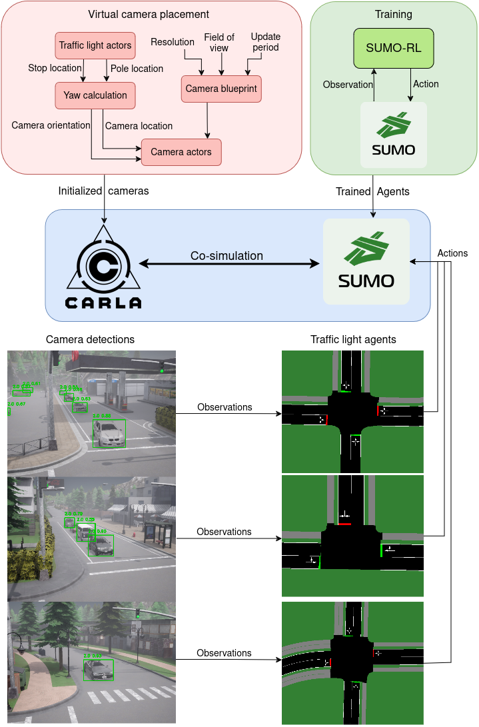
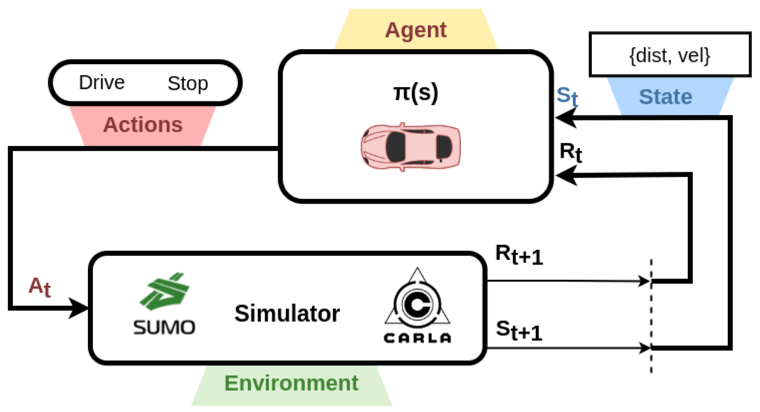
Simulation on SUMO: Driver Behaviour
CARLA and SUMO C0- simulation
The diagram illustrates a reinforcement learning loop for autonomous driving, where an agent (autonomous vehicle) interacts with an environment simulated by SUMO and CARLA. Based on its current state (distance, velocity), the agent selects an action (drive, stop) which is fed into the simulator. The simulator then provides a reward and the next state, which are used to update the agent's policy (π(s)).
Integration of SUMO and CARLA

Slide 29
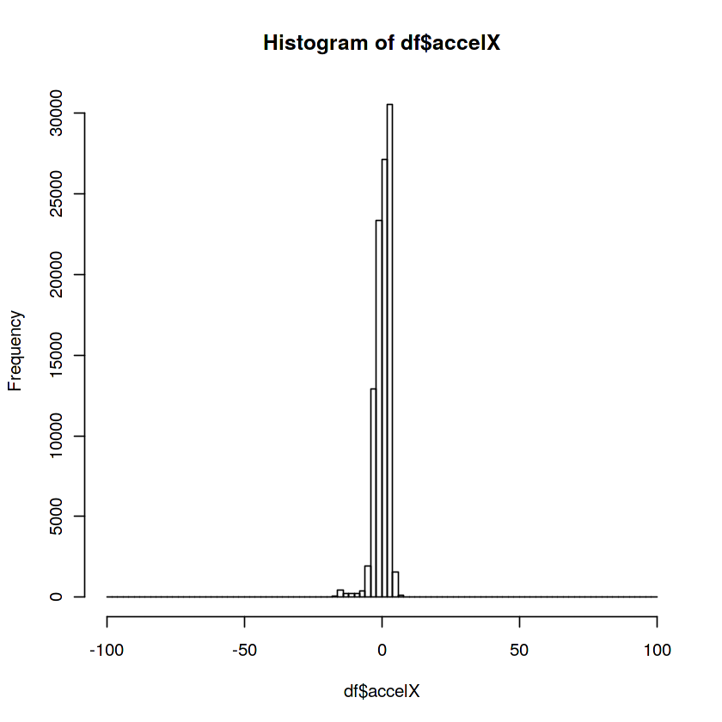
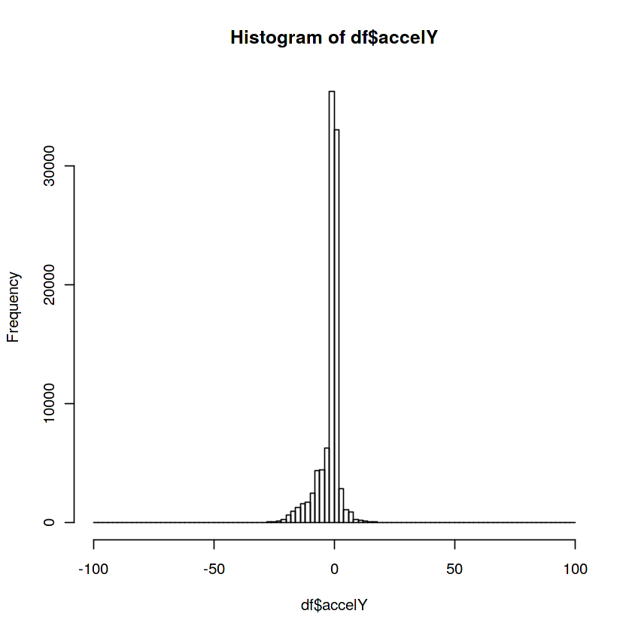
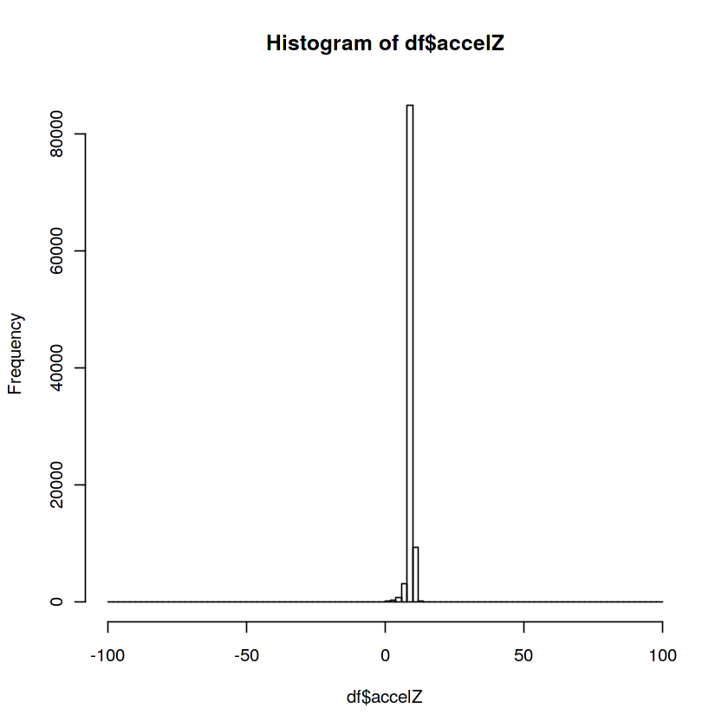
Simulation on SUMO: Driver Behaviour
CARLA Dataset: Acceleration Data
The driver predominantly maintains a constant speed with minimal acceleration or deceleration events in all directions, suggesting steady driving habits. Occasional small accelerations indicate minor adjustments, likely for maintaining lane position or adapting to slight changes in traffic flow.
Visual frequency representation of acceleration across the axis

Slide 30
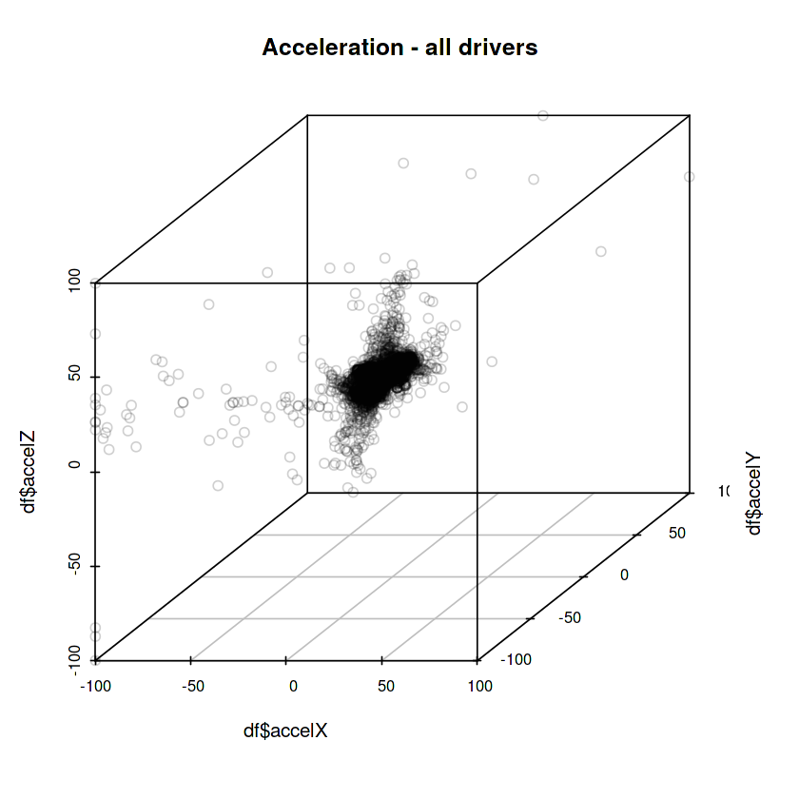
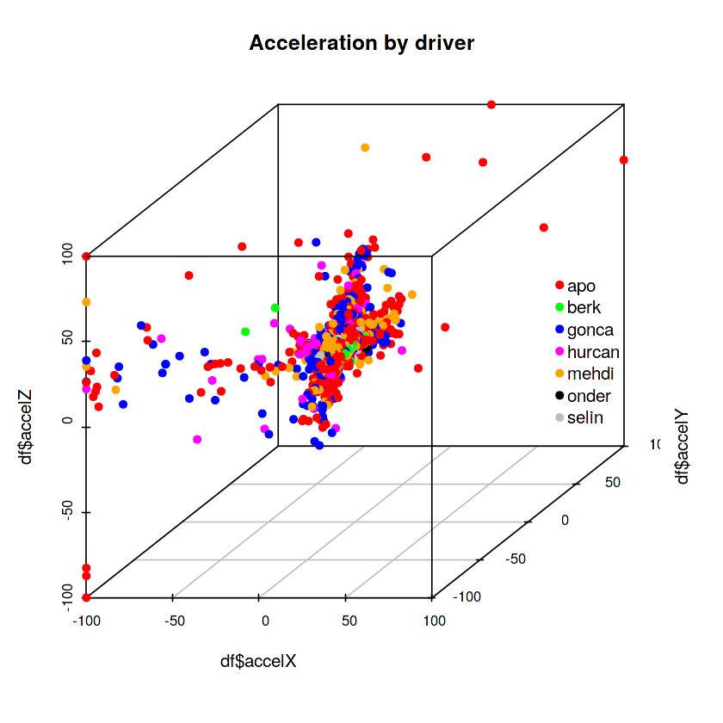
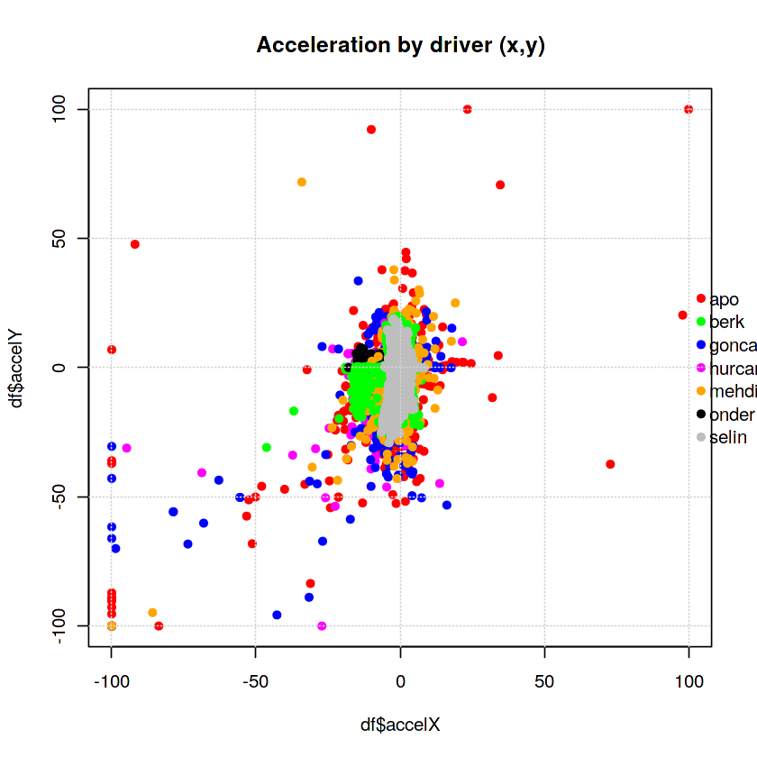
Simulation on SUMO: Driver Behaviour
CARLA Dataset: Acceleration Data
Most drivers tend to operate with low accelerations in all directions, indicating a generally smooth and controlled driving style. However, some drivers exhibit extreme acceleration and deceleration events, suggesting more aggressive or erratic maneuvering.
Visual distribution of acceleration among different classes

Slide 31
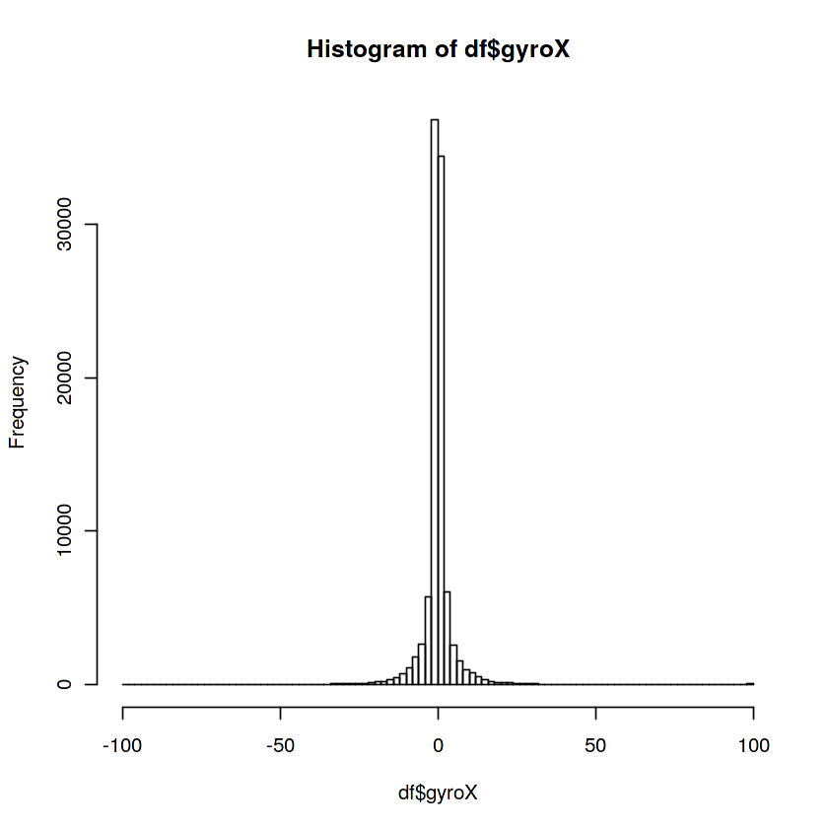

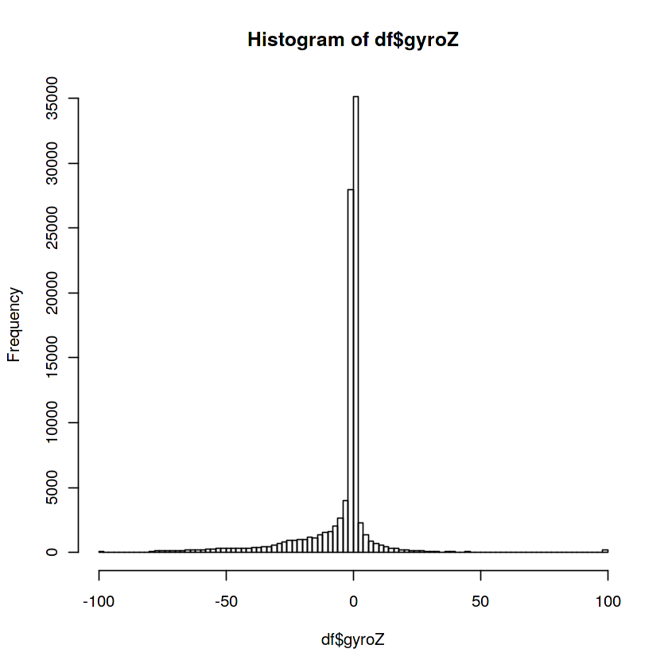
Simulation on SUMO: Driver Behaviour
CARLA Dataset: Gyroscope Data
The driver primarily keeps the vehicle stable with minimal rotational movement along all three axes (X, Y, Z), indicating infrequent and subtle steering adjustments. Larger deviations suggest occasional sharper turns or corrections, but the overall driving behavior is characterized by smooth and controlled handling.
Visual frequency representation of gyroscope across the axis

Slide 32
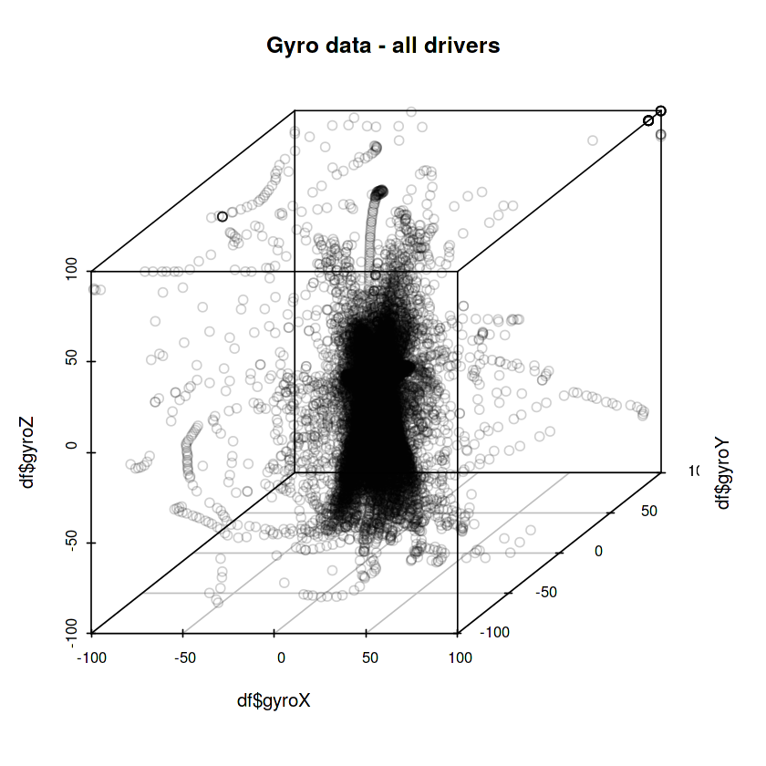
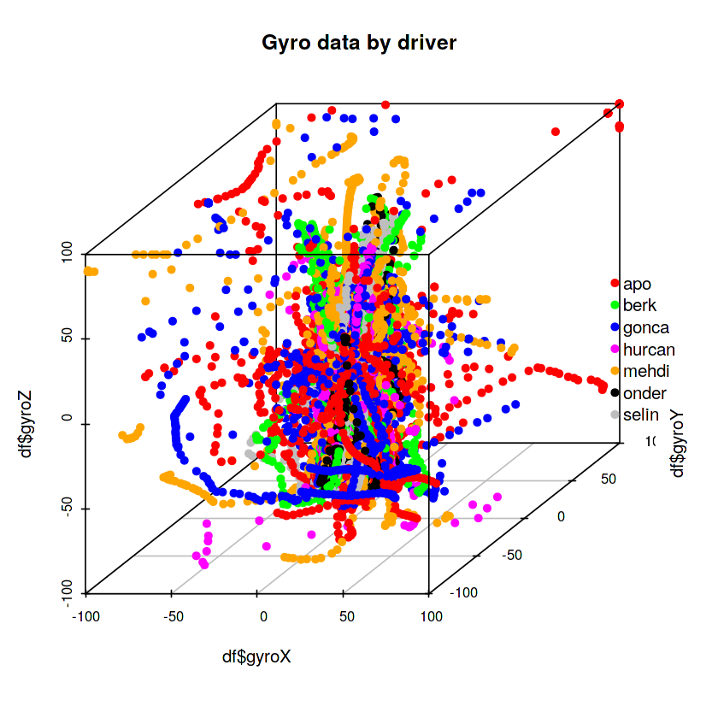
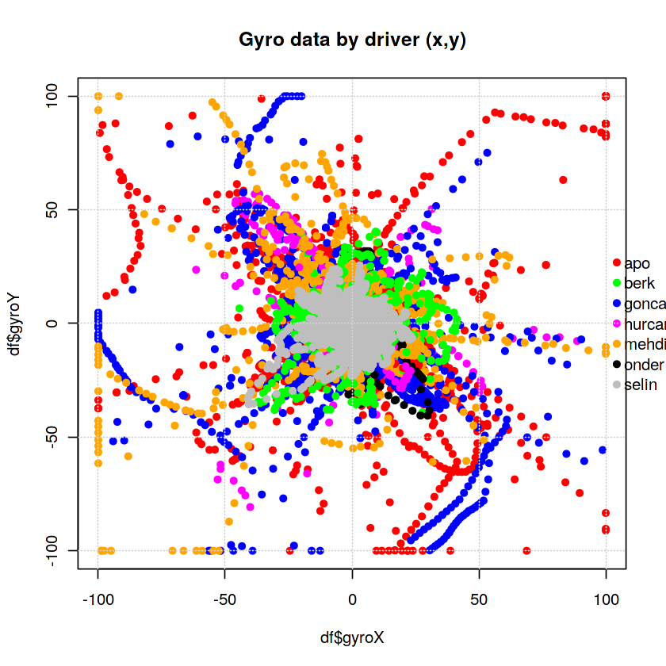
Simulation on SUMO: Driver Behaviour
CARLA Dataset: Gyroscope Data
The majority of drivers (represented by the dense cluster around the center) exhibit relatively low and controlled rotational movement, indicating a generally smooth driving style with minimal sharp turns or excessive corrections. However, distinct driving styles are evident, with some drivers showing significantly larger excursions in rotational movement across all axes (X, Y, Z), pointing to more dynamic or aggressive handling.
Visual distribution of gyroscope among different classes

Slide 33
TATA POWER
TASK V
Representation of the SUMO simulation for: Traffic efficiency and Unsafe Situations

Slide 34
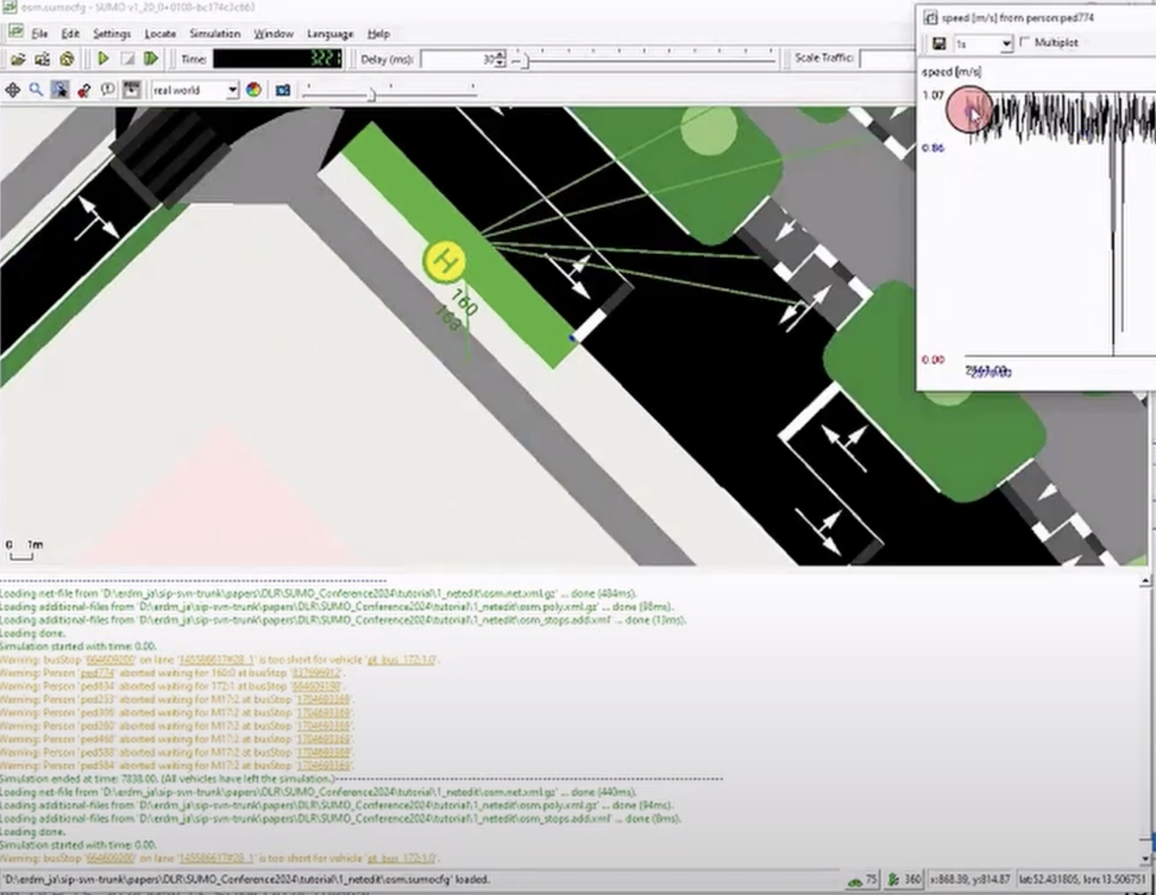
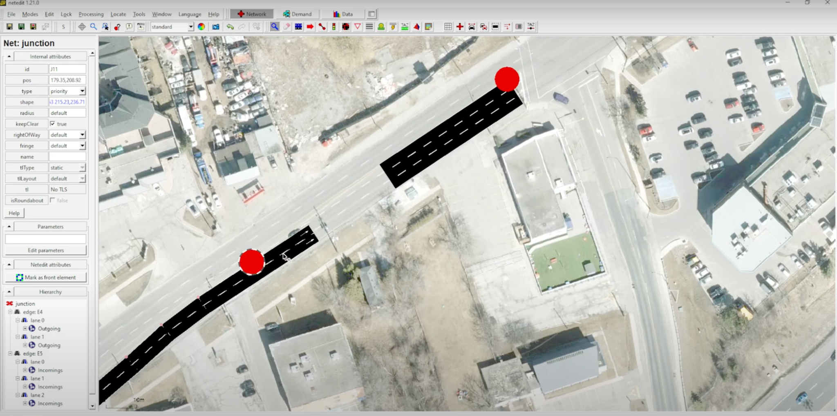
Representation of the SUMO simulation
Applying parameters
A visual representation of setting up parameters like speed, gyroscopic moment etc in SUMO and a real street view
Demonstration of the simulation

Slide 35
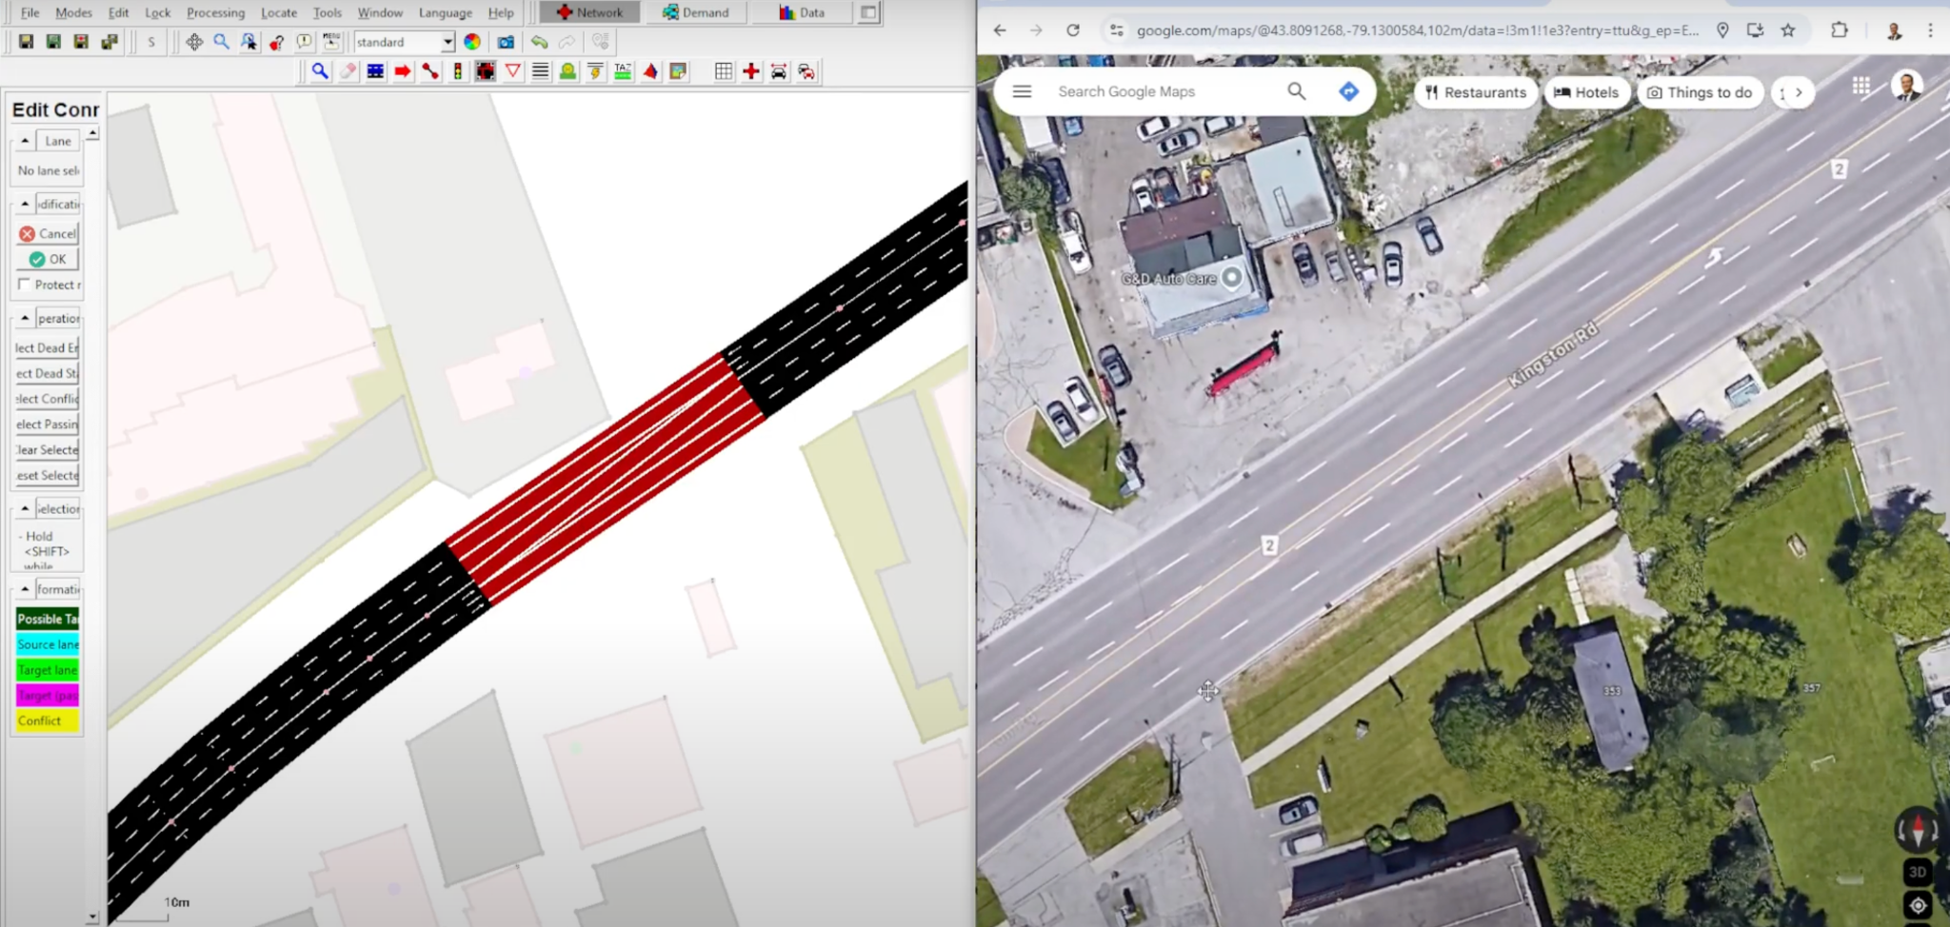
Representation of the SUMO simulation
Real world scenario
A visual representation of a street on google maps and on SUMO
Demonstration of a real life street on SUMO

Slide 36
TATA POWER
TASK VI
If pedestrians are allowed to cross roads at any arbitrary locations instead of fixed zebra crossings, how much does the traffic efficiency reduce (assuming vehicles slow down whenever a pedestrian is crossing in front of it)?
Traffic efficiency means average travel time of all vehicles.
If pedestrians are allowed to cross roads at arbitrary locations, how often does this create an unsafe situation (vehicle coming too close to pedestrian)?

Slide 37
Traffic Efficiency
Key setup parameters
SUMO can quantitatively analyze how arbitrary pedestrian crossings impact traffic efficiency through controlled simulations.
Pedestrian Behaviour
Vehicle Behaviour
Crossing frequency: Set to 1–5 crossings/minute (varies by pedestrian density)
Crossing speed: 1.2–1.5 m/s (human walking speed)
Risk tolerance: 20–40% chance of crossing without checking traffic
Deceleration rate: 2.5–4.0 m/s² (realistic braking for yielding)
Reaction time: 1.0–1.5 seconds (human driver response delay)
Minimum gap: 2.0–3.0 m (distance maintained from pedestrians)
Pedestrian and vehicle behaviour for analyzing traffic efficiency

Slide 38
Traffic Efficiency
Metrics to look out for analyzing traffic efficiency
Metrics to monitor
Metric | Definition | Thresholds
Average travel time | Total vehicle travel time / no. of vehicles | >25% increase = critical degradation
Time loss | Delay due to stops/slowdowns | >30 sec/km = severe congestion
Pedestrian conflicts | No. of near-misses per hour (vehicles <1m) | >10 conflicts/hr = unsafe
Vehicle throughput | No. of vehicles passing a point per hour | <500 veh/hr/lane = poor efficiency
Necessary threshold discussion to monitor traffic efficiency

Slide 39
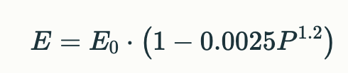
Traffic Efficiency
Quantitative Analysis
The relationship between pedestrian density (P, ped/km²/hr) and traffic efficiency (E) can be modeled as
Term | Description | Example Values
E | Actual traffic efficiency (vehicle-km/hour) | 0.82 · E₀ (82% of baseline)
E₀ | Baseline efficiency (vehicle-km/hour without pedestrians) | 1000 vehicle-km/hr
P | Pedestrian density (pedestrians/km²/hour) | 500 ped/km²/hr
0.0025 | Scaling factor (calibrated from real-world data) | Fixed constant
P¹·² | Non-linear pedestrian impact (density raised to 1.2 power) | 500¹·² ≈ 3,800
A quantitative analysis of traffic efficiency

Slide 40
Traffic Efficiency
Observed results
The results obtained on traffic efficiency reduction, critical density thresholds, and spatial impact
Traffic Efficiency Reduction :
1. 15–25% increase in average travel time for moderate pedestrian density (500–800 ped/hr)
2. 35–40% increase at high pedestrian density (>1,200 ped/hr)
Example: A 10 km urban route with baseline 20-min travel time becomes 24–28 mins with arbitrary crossings
Critical Density Thresholds :
1. Linear degradation: Travel time increases ~0.5% per 100 ped/hr up to 800 ped/hr
2. Exponential degradation: Beyond 800 ped/hr, travel time rises ~1.2% per 100 ped/hr
Spatial Impact :
1. Mid-block crossings cause 3× more delays than intersections
2. 70% of conflicts occur within 50m of intersections, even without formal crossings
Results obtained after simulations and statistical analysis

Slide 41
Unsafe Situation
Key setup parameters
SUMO simulations can quantitatively assess unsafe vehicle-pedestrian interactions caused by arbitrary crossings.
Pedestrian Behaviour
Vehicle Behaviour
Crossing frequency: 2–4 crossings/minute per pedestrian
Risk tolerance: 20–30% chance of crossing without checking traffic
Speed variation: 0.8–1.5 m/s (elderly to hurried pedestrians)
Reaction time: 1.0–1.5 seconds (human driver delay)
Emergency deceleration: 4.0–6.0 m/s² (harsh braking scenarios)
Yielding compliance: 60–80% of drivers (varies by culture)
Pedestrian and vehicle behaviour for analyzing unsafe situation

Slide 42
Unsafe Situation
Metrics to look out for analyzing unsafe situation
Metrics to monitor
Metric | Definition | Thresholds
Near-miss rate | Vehicle-pedestrian distance <1.0m | >15 events/hour
Emergency braking | Deceleration >4 m/s² | >10% of vehicles
Time-to-Collision (TTC) | Time until collision if speeds continue | <1.5 seconds
Intrusion duration | Pedestrian on road per crossing | >5 seconds
Necessary threshold discussion to monitor unsafe situation

Slide 43
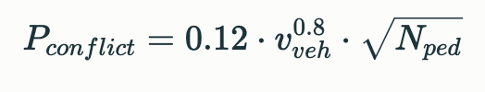
Unsafe Situation
Quantitative Analysis
The conflict probability formula can be modeled as
Term | Description | Example Values
0.12 | Baseline risk factor from empirical studies | Constant
v_veh | Vehicle speed (meters/second) | 13.9 m/s (50 km/h)
N_ped | Pedestrian density (pedestrians/hour within 100m radius) | 800 pedestrians/hour
v_veh^0.8 | Non-linear speed impact (doubling speed increases risk by ~74%) | 13.9^0.8 ≈ 8.7
√N_ped | Square root scaling of pedestrian density | √800 ≈ 28.3
A quantitative analysis of unsafe situation

Slide 44
Unsafe Situation
Observed results
The results obtained on conflict frequency, behavior patterns, and spatial distribution
Conflict Frequency :
1. Mid-block crossings: 3.2× more conflicts than intersections
2. Peak hours (1,200+ ped/hr): 25–35 unsafe events/hour
3. Speed correlation: 70% of conflicts occur when vehicles >40 km/h
Behavior Patterns :
1. Risk-taking pedestrians (15–20% population) cause 55% of conflicts
2. 35% of drivers fail to yield within safe stopping distances
Spatial Impact :
1. 65% of conflicts occur within 50m of intersections
2. Bus stops generate 2.5× more conflicts than average locations
Results obtained after simulations and statistical analysis

Slide 45
TATA POWER
TASK VII
Recommendations to tackle the problem of: Traffic efficiency and Unsafe situations

Slide 46
Traffic Efficiency
Detailed recommendations to tackle this problem
Crosswalk placing
Design Interventions
Frequency: Install crossings every 80–150m in urban cores
Threshold: >25 pedestrians/hour triggers need for marked crossing
Location Priorities:
Mid-block near transit stops (50m radius)
Within 100m of schools/hospitals
Align with natural desire lines (85% compliance when placed correctly)
Feature | Impact | Implementation Cost (Per 30 sq km)
Raised crosswalks | 40% reduction in pedestrian crashes | Medium ($15–25k)
LED-embedded crossings | 62% better nighttime visibility | High ($30–50k)
Curb extensions | 35% slower vehicle speeds | Medium ($20–30k)
Placing and design interventions for traffic efficiency problem

Slide 47
Traffic Efficiency
Detailed recommendations to tackle this problem
Technology integration
Safety-capacity balance
Smart Signals:
Adaptive timers reducing pedestrian wait time by 40%
Pedestrian-actuated beacons decreasing jaywalking by 55%
Detection Systems:
Thermal cameras alert drivers 50m before crossings
Mobile apps showing real-time crossing opportunities
Critical Thresholds:
Vehicles: >800 veh/hr/lane → signalize crossings
Pedestrians: >75 crossings/hr → install refuge islands
Speed Management:
30 km/h zones near crossings reduce fatalities by 65%
Optical speed bars + narrowing → 12–15% speed reduction
Technology and safety balance for traffic efficiency problem

Slide 48
Unsafe Situation
Detailed recommendations to tackle this problem
Infrastructure design
Crosswalk Spacing:
Install semi-controlled crossings every 120-150m in areas with >500 ped/hr
Use raised crosswalks (7-10 cm height) to force 30-40% speed reduction
Traffic Calming:
Implement optical narrowing (3.0-3.5m lane width) near schools/hospitals
Add chicanes with 15-20° deflection angles to limit speeds to 30 km/h
Zone Type | Design Features | Conflict Reduction
School areas | Flashing beacons + speed humps | 55-60%
Commercial corridors | Refuge islands + pedestrian countdowns | 40-45%
Transit hubs | Elevated crossings + tactile paving | 50-55%
Infrastructure interventions for tacking unsafe situation

Slide 49
Unsafe Situation
Detailed recommendations to tackle this problem
Technology integration
Cost-effective solutions
Smart Systems:
Thermal cameras triggering LED warnings 50m ahead of crossings
Adaptive signals prioritizing pedestrians during peak hours (70-90% green time)
Vehicle-to-Pedestrian (V2P):
Mobile apps alerting drivers to hidden pedestrians (30% faster reaction time)
On-board units warning drivers via haptic steering (↓ 40% late braking)
Intervention | Cost (USD/m) | Effectiveness | Implementation Time
Pavement markings | $15-20 | 25-30% | 1-2 days
Rubber speed humps | $50-80 | 40-45% | 3-5 days
Curb extensions | $120-150 | 35-40% | 2-3 weeks
Technology and cost effective solutions for solving unsafe situation

Slide 50
THANK YOU

